Slide 1

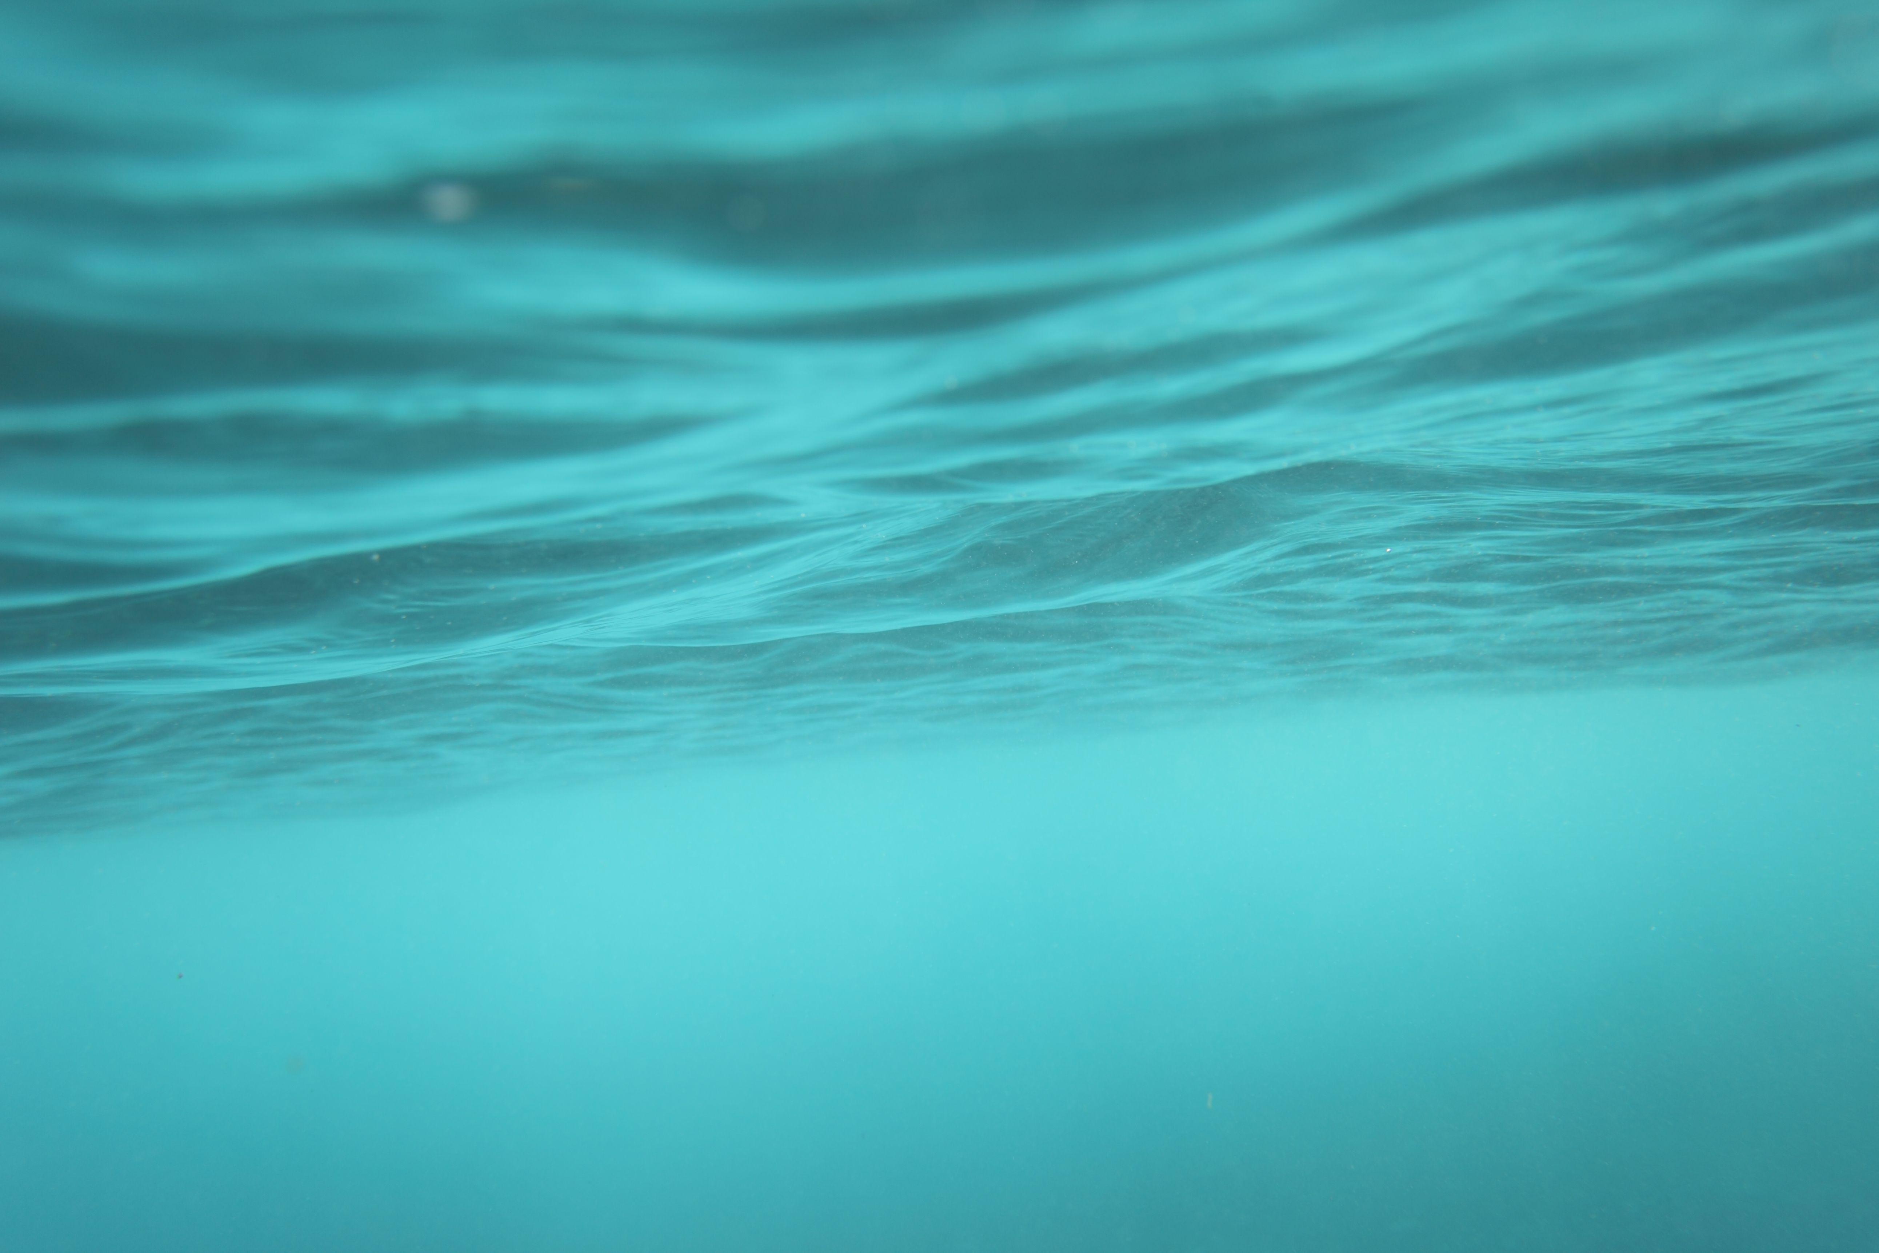
Capital Plan discussion
Water Department – Fire District No.1

Slide 2
History of Capital Improvements
The Water Department – Fire District No.1 has made significant improvements within the distribution system over the last 22 years. Other improvements have been made prior to information contained within this presentation.
Water infrastructure across the country is aging and in need of replacement. The Fire District has done a great job addressing those concerns historically, but we have a long way to go. Total cost of the improvements to date is $3,675,840.35.
Some examples of those improvements are as follows:

Slide 3
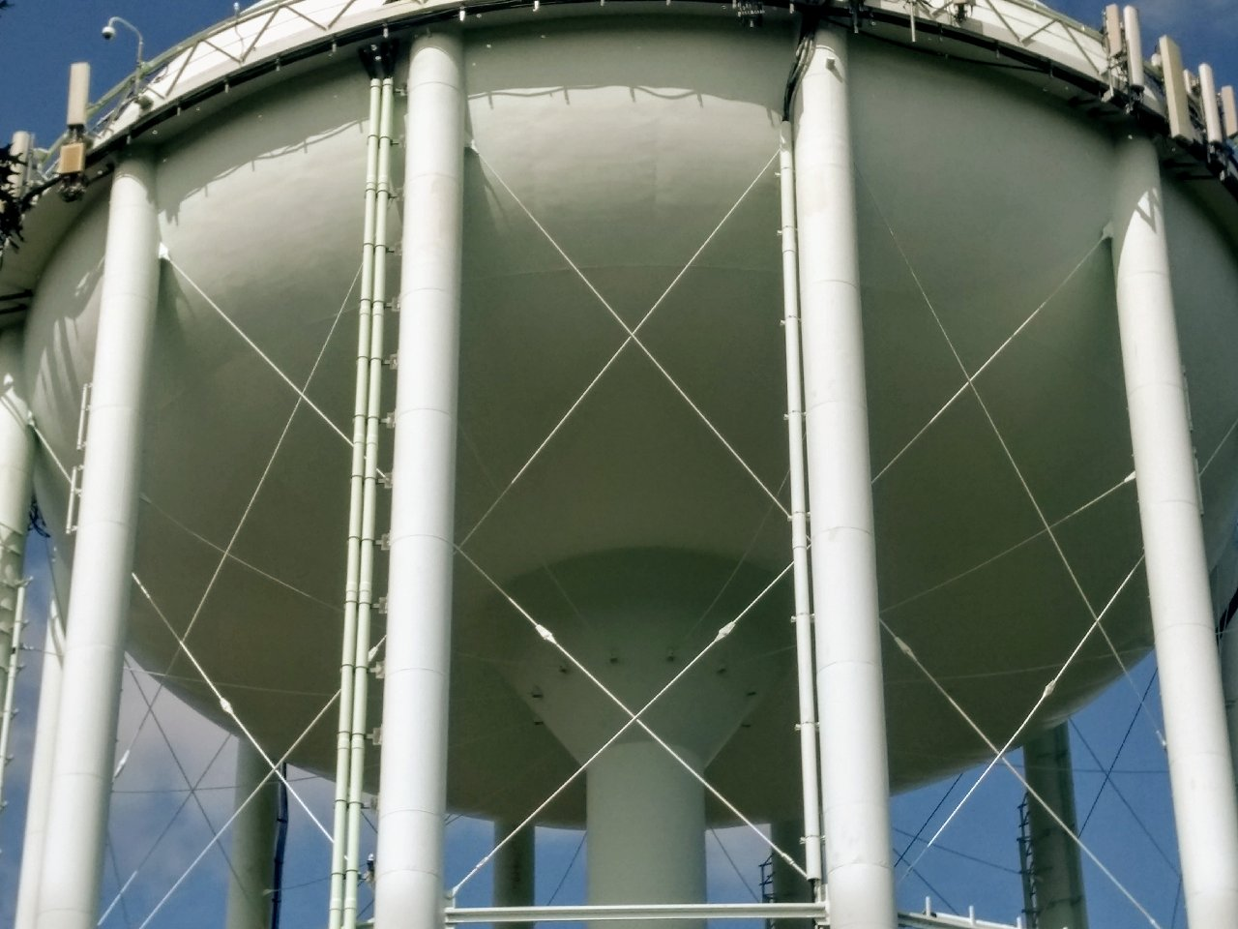
Alvord St. Water Tank @14 Mulligan Dr.
1.5 Million Gallons
Exterior Tank Painting 2003 $799,000.00
Coating has a projected life span of 15 to 20 years. Tank was evaluated by Core Tek in November of 2022 and recommended an overcoat in 3-5 years and would extend the current coating system an additional 8-10 years. Alternatively, a full blast of the exterior and recoating would provide a coating lifespan of 25-30 years.
Interior Tank Painting 2015 $683,000.00
Coating system was a 30 mil plural component system that has a projected lifespan of 30+ years. The District is required to perform interior inspections every 3-5 years. Last inspection and interior cleaning was 2021.

Slide 4
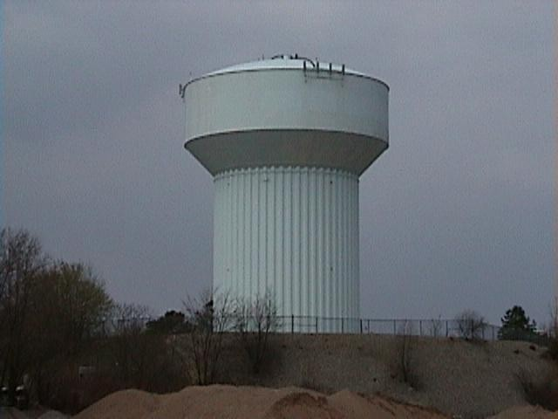
Industrial Dr. Tank @ 8 Industrial Dr.
1.5 Million Gallons
Exterior Tank Painting 2005 $403,131.00
Same language from Core Tex applies to this tank. Coating System is in exceptional condition. Water Dept. Staff performed spot repairs in the fall of 2022 to address rust areas.
Interior Tank Painting 2010 $ 399,425.00
The District is required to perform interior inspections every 3-5 years. Last inspection and interior cleaning was 2019.

Slide 5
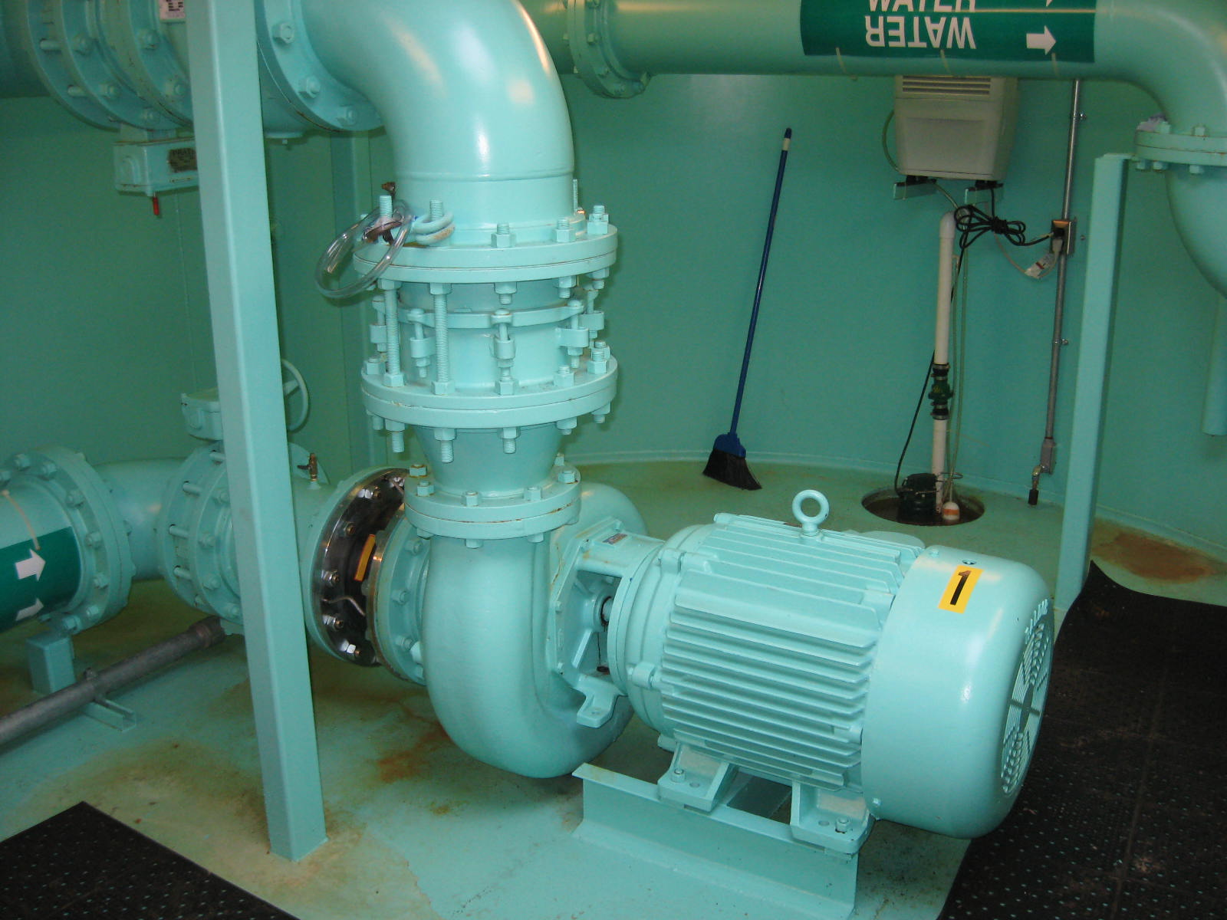
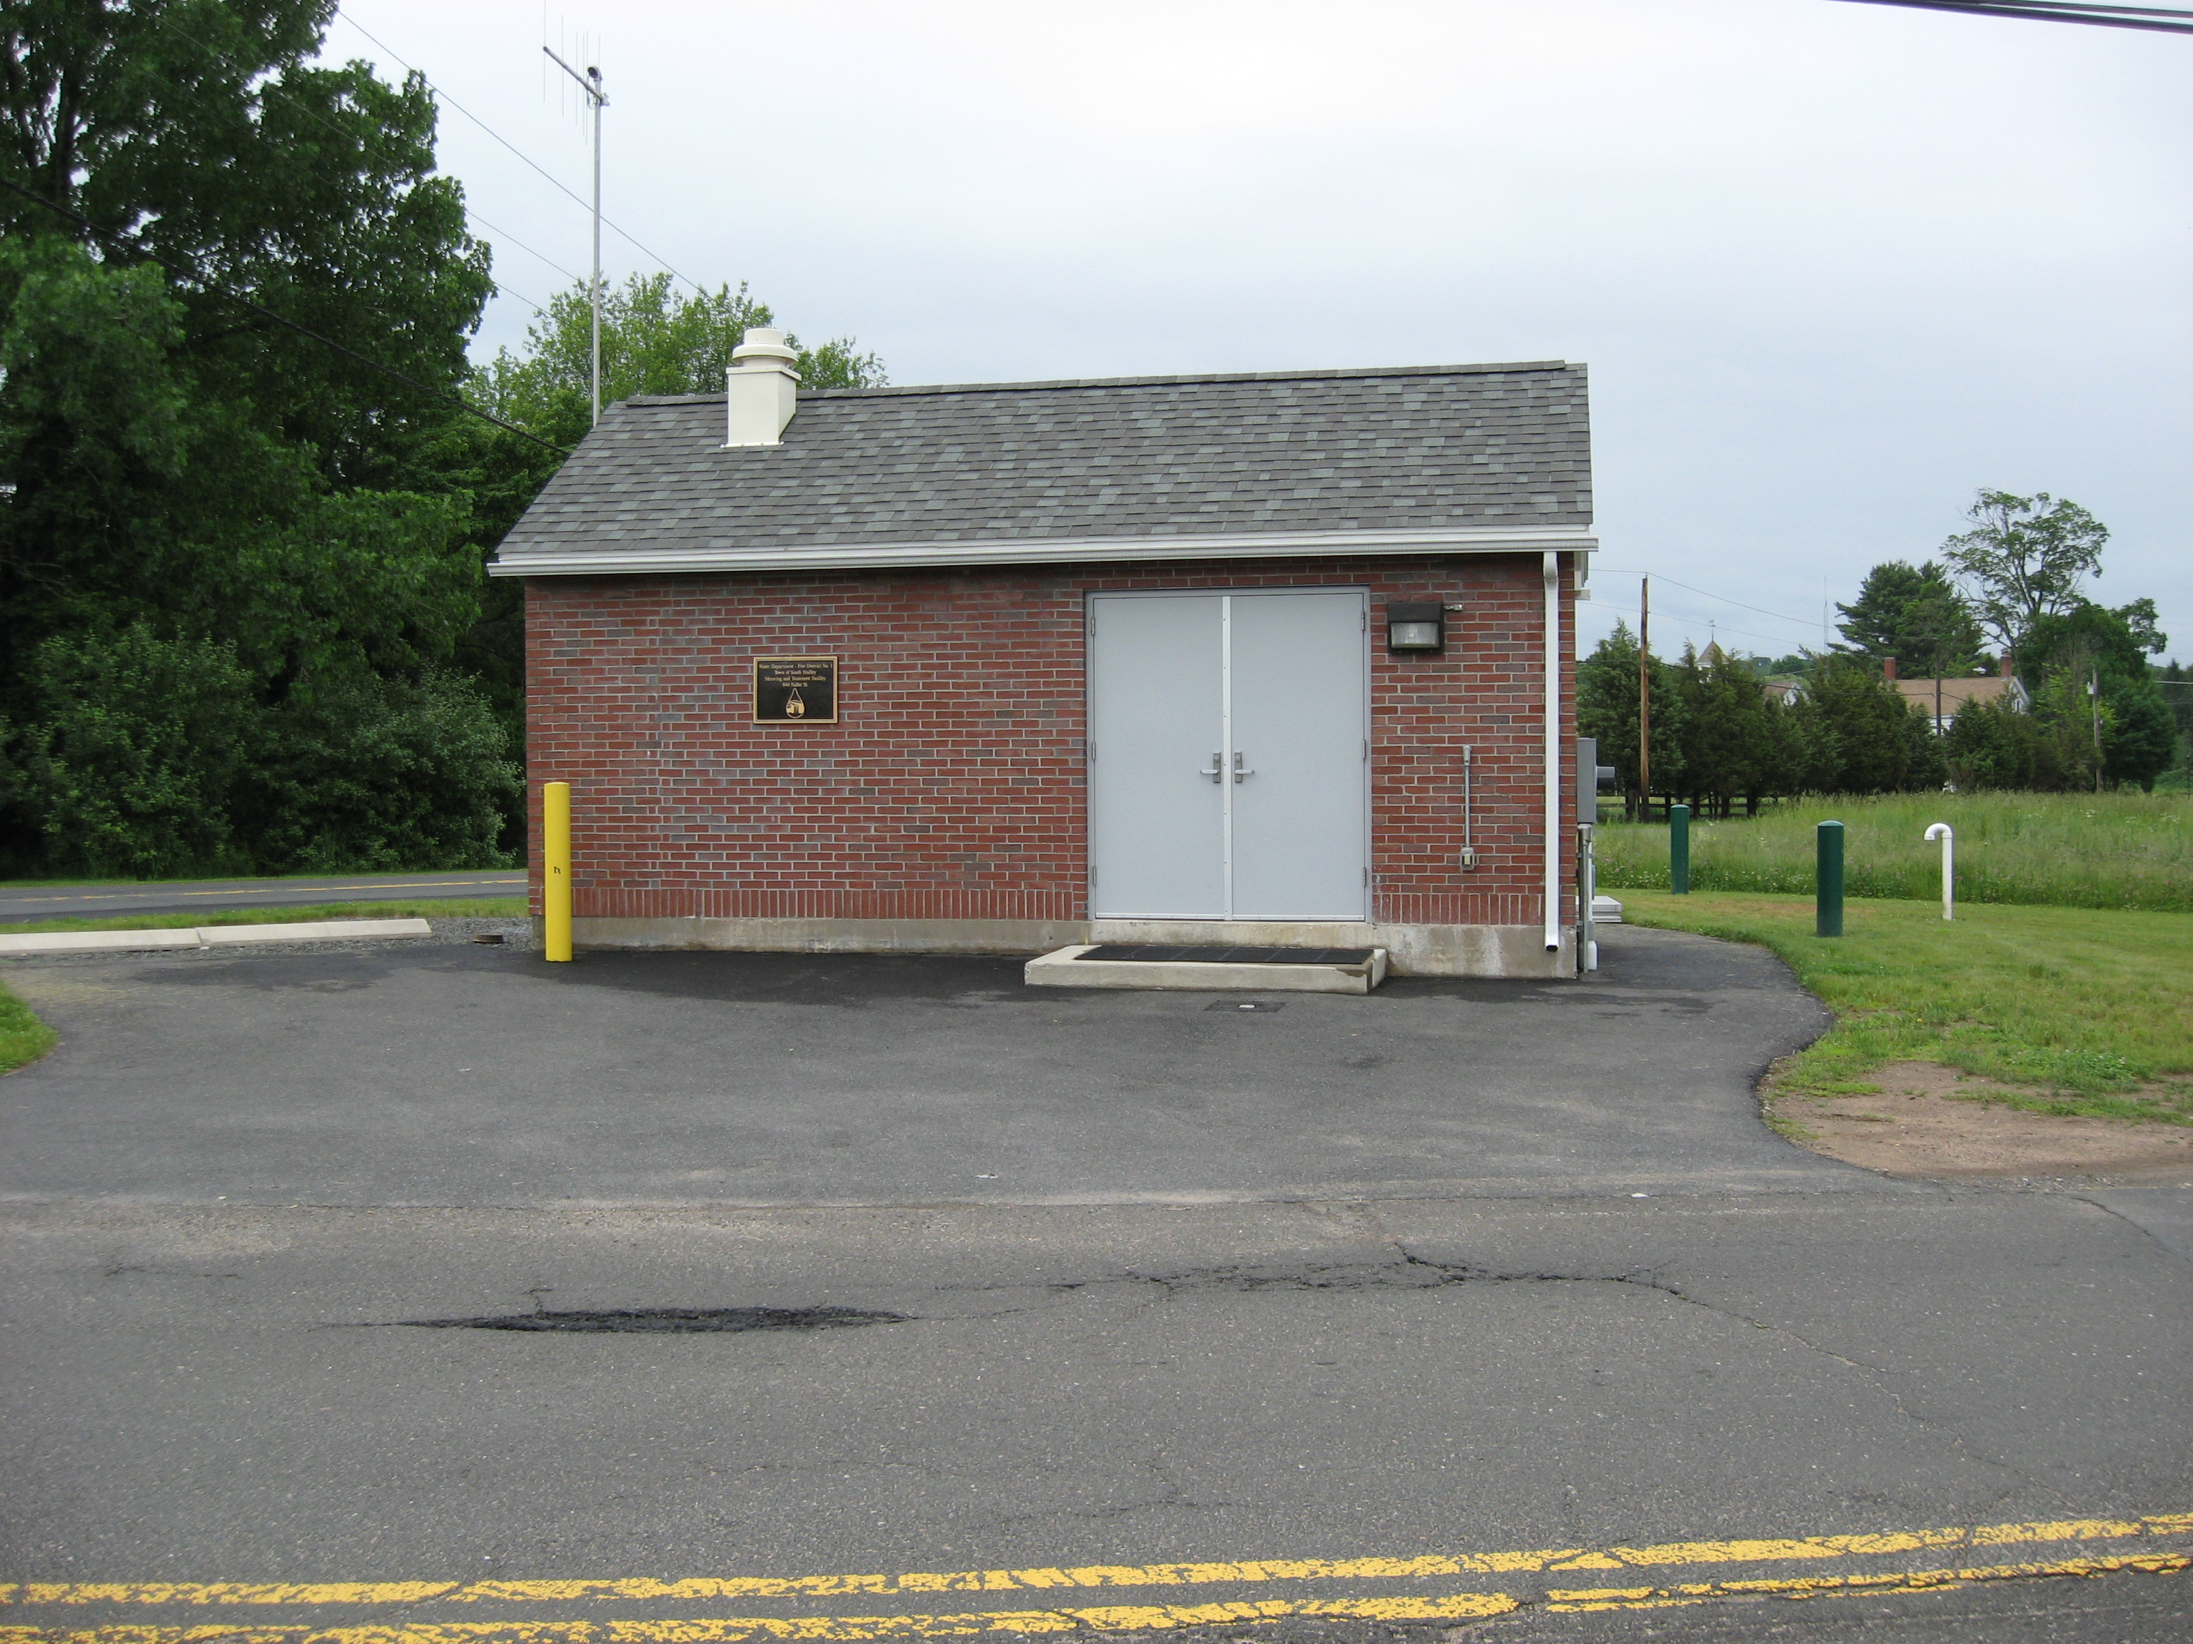
Ludlow Treatment Facility
@444 Fuller St. Ludlow
Upgrade to Ludlow Facility 2006 $1,089,000.00
Upgrade included the installation of a 100 horsepower booster pump. The District Bonded for this project through the State Revolving Fund (presently Clean Water Trust) for a 20 year note at 2% interest. The Bond will be fully paid in July of 2025.

Slide 6
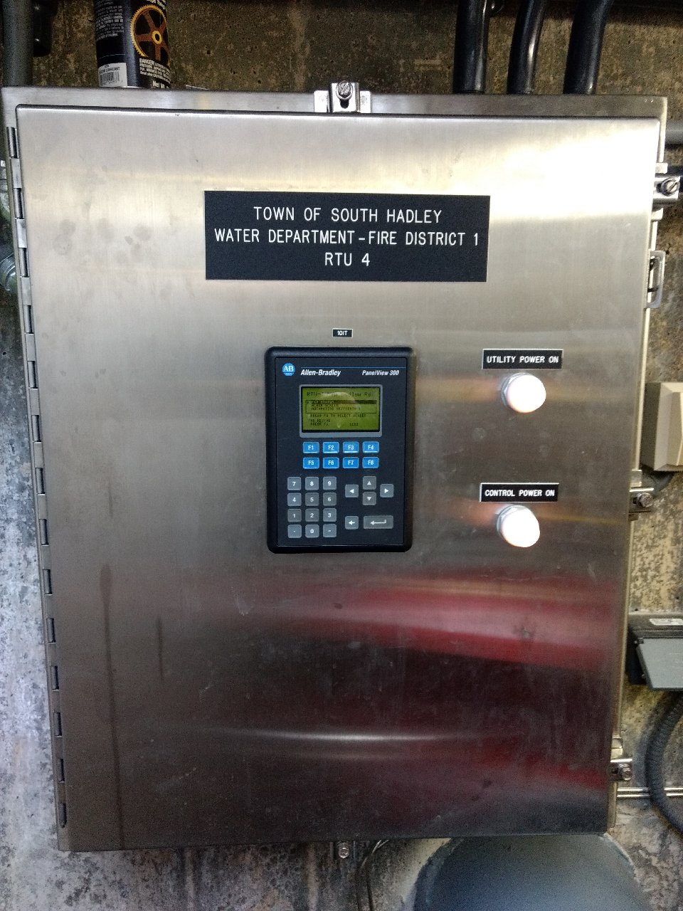
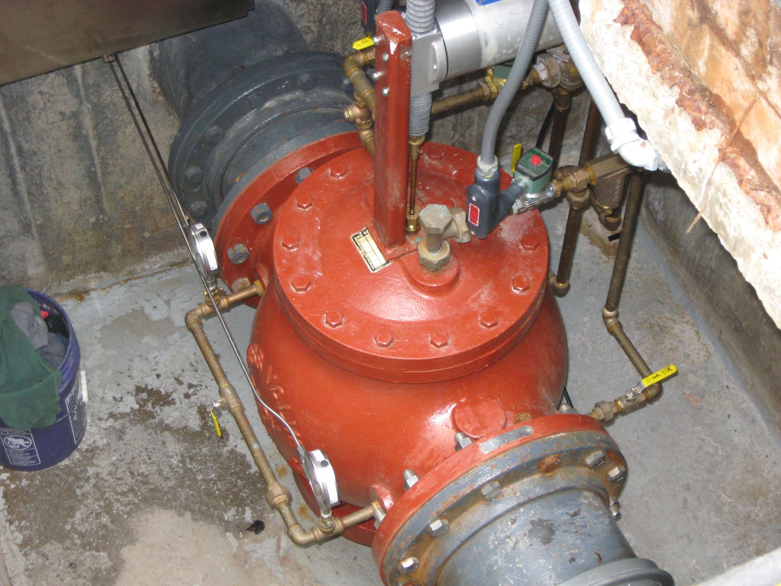
Pressure Regulating Valve Vault@ So. Hadley/ Granby Line on New Ludlow Rd.
Implementation of SCADA System 2001 $240,000.00
PLC’s were upgraded in 2021 $55,000.00
Valve was rebuilt in 2022 $ 7,284.25
Implementation included rebuilding of the valve and installing programmable logic controllers at 4 locations within the district as well as the Ludlow Facility as part of the upgrade.

Slide 7
Water Main Replacement
Fire District No. 1 is responsible for maintaining approximately 82 miles of watermains.
The Following Excel spreadsheets on the next 4 slides indicate all of the watermains that have been replaced within the last 22 years. In addition, there were water mains that were replaced prior to 2002 and all were subcontracted out to install them. Thankfully most of the work in the following slides has been performed in-house maximizing funding and saving the ratepayers.

Slide 8
In summary, a total of 51 streets have upgraded watermains. Some mains were funded through grants and other monies as indicated in red. Here is a summary of those efforts.
A total of 64, 026 ft. or 12.13 miles of watermain have been replaced.
Total cost of those replacements was $ 3,564,476.47. The Newton St. Watermain was the only borrowing the District incurred with a 0% loan for 10 years from the MWRA. There is 4 yrs. remaining on loan @$203,000.00 per year.

Slide 9
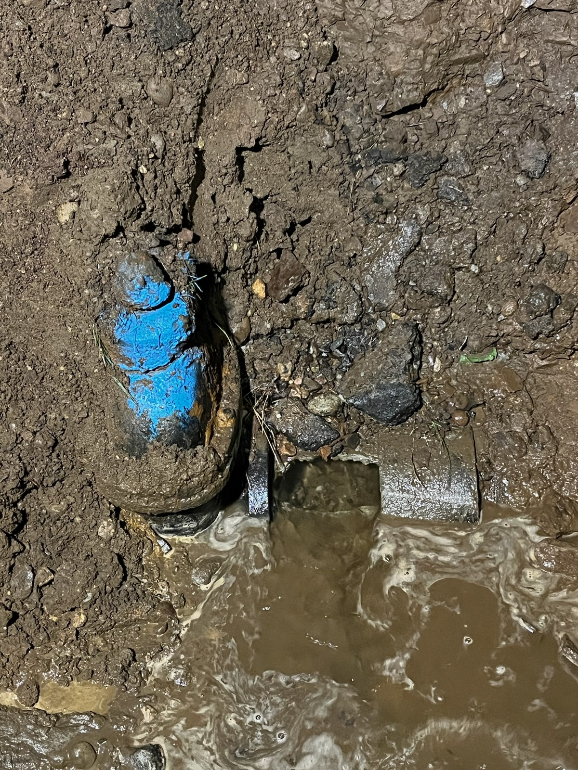
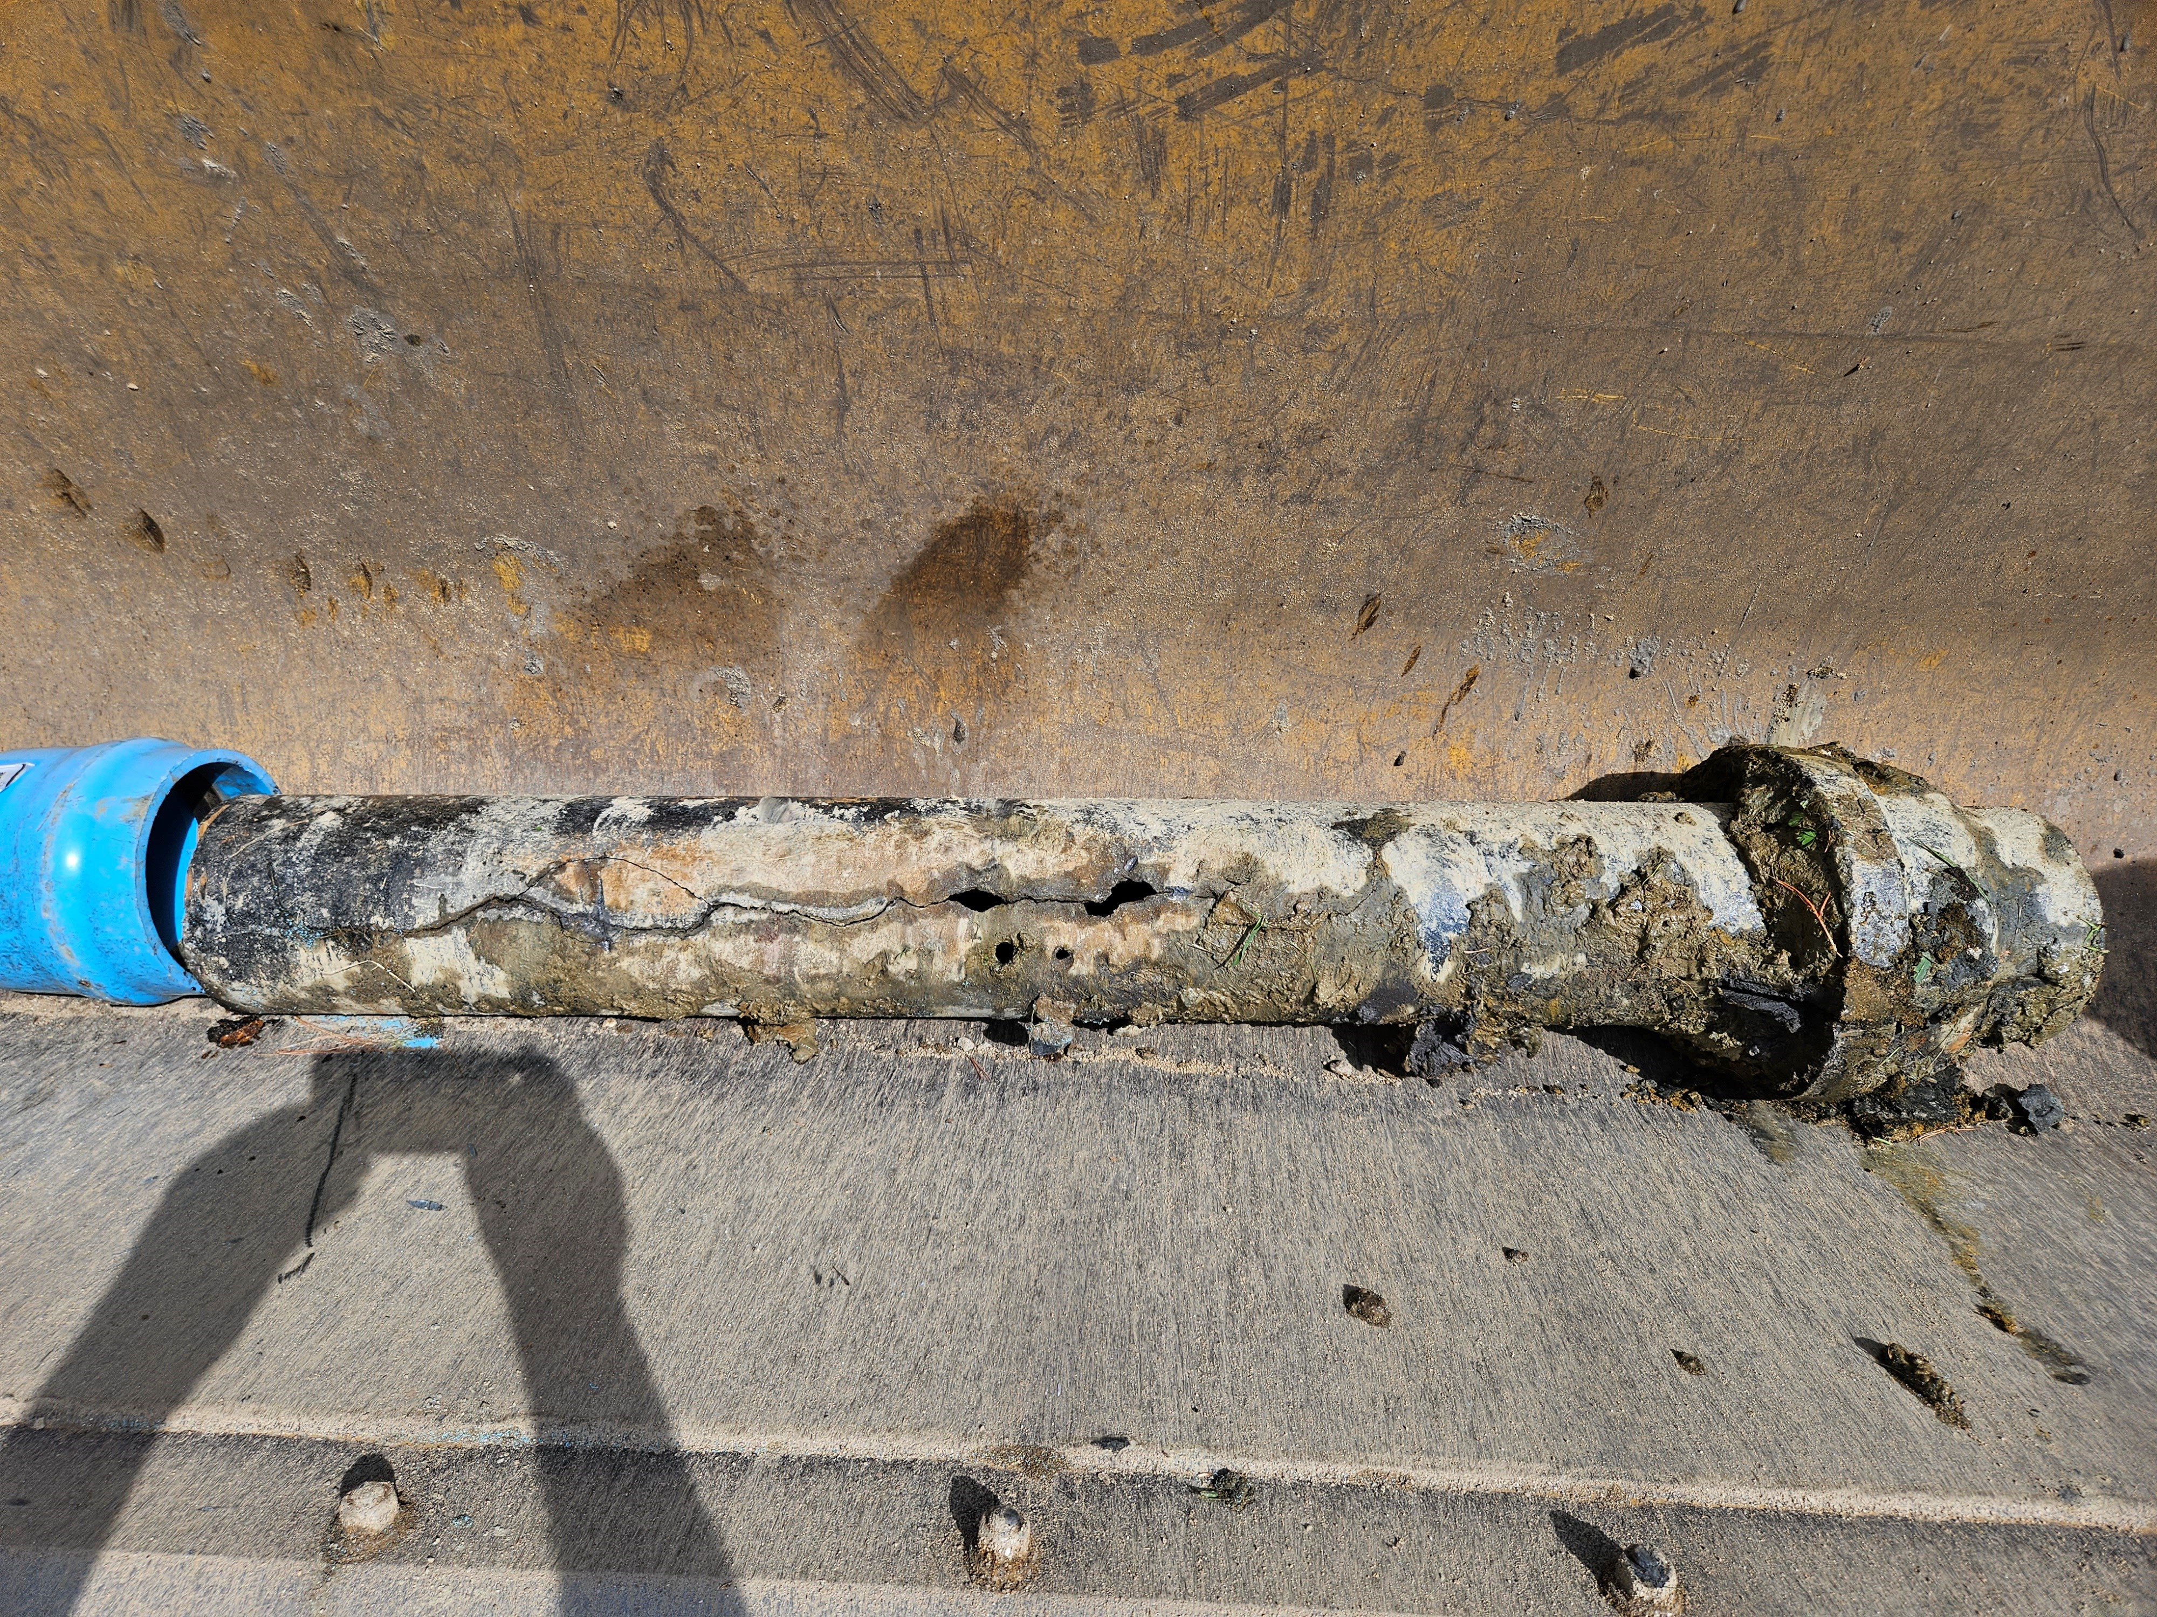
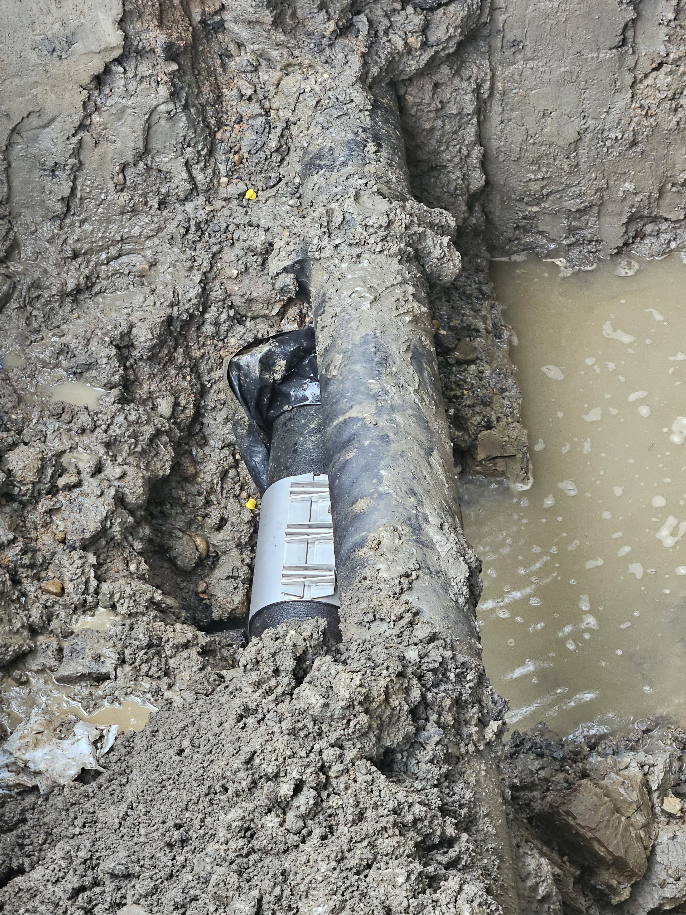
Examples of aging infrastructure

Slide 10
Future Capital Needs
As mentioned previously, the District has done a great job addressing a lot of the appurtenances within the distribution system. As you can see, those improvements were completed within the last 23 years. In addition, there is an extensive list of improvements that need to be addressed in future years to come. As you may, or may not be aware, these improvements need to be paid from sources within the Water Dept. budget. Examples of those sources are the following:
Water Available Surplus (Monies left over from previous fiscal year, cell tower rental revenue, excess water receipts)
Stabilization Funds (Savings accounts from monies appropriated from Surplus)
Water Rates (receipts) (Water Rates established by the Board of Water Commissioners)
Borrowing in the form of loans

Slide 11
Current Balances in Accounts
Water Stabilization $711,508.89
Water Tank Stabilization $924,770.89
Replacement of New Mains Acct. $145,767.80
Critical Infrastructure Stabilization $243,772.03
OPEB Trust Acct. $372,61.10 (Future Health insurance funding)
Water Available Surplus ???????
Water Rate is currently $3.92/ hcf since 2017

Slide 12
Capital Needs by Category
Ludlow Facility
New Roof 1-2 yrs. Est. $5000.00
Alvord St. Water Tank
Exterior Painting 3-5 yrs. Est. $1,500,00.00
Interior Painting (no Est. at this time Continue to monitor through inspections)
Rebuild Altitude Valve 2-3 yrs. Est. $5,000.00
Industrial Dr. Water Tank
Exterior Painting 5-10 yrs. Est. $1,500,00.00
Interior Painting (no Est. at this time Continue to monitor through inspections)
Rebuild Altitude Valve 2-3 yrs. Est. $5,000.00
Pressure Regulating Valve Vault
Re-building of Valve 5-10 yrs. Est. $10,000.00

Slide 13
Capital Needs by Category Cont.
Maintenance Facility
New Flat Roof 5-10 yrs. Est. $40,000.00
New Shingle Roof 20-25 yrs. (no Est. at this time)
New Paved lot 10-15 yrs. (no Est .at this time)
Office Building
Furnace replacement. Current furnace is 20 years old
Replacement of carpet
Tree removal behind the office building along edge of reservoir
Vehicles
Replacement for W-4 (2012) 3-5 yrs. Est. $100,000.00
Replacement of W-3 (2016) 5-10 yrs. Est. $75,000.00
Replacement of W-5 (2004) 5-10 yrs. Est. $150,000.00
Replacement of W-7 (2007) 1-2 yrs. Est. $ 75,000.00 (obsolete parts)

Slide 14
Capital Needs by Category Cont.
Water Meters
The District has been slowly changing water meters by upgrading to new Iperl ultrasonic meters. Iperls have a 20 year battery life and are throw away.
A total of 3,300 meters are needed at a current cost of $160.05 each for a total cost $528,165.00.
Can be replaced over the next 10 years in order to be complete.

Slide 15
Capital Needs by Category Cont.
Water Mains
Lincoln St. (1950) 8” AC 2600 ft.
Roosevelt Ave. (1966) 8” AC 2000 ft.
Spring St. ext. (1963) 8”AC 820 ft.
Pleasant St. (1964) 8” AC 500 ft.
South Main St. (1955) 6”CI 650 ft. (details)
Pittroff Ave. (1958) 8” AC 1400 ft.
Berwyn St. ext. (1962) 8” AC 1000 ft.
Brainerd St. (1951) 8” AC 3315 ft.
16’’ pipeline (1951) from our take-off in Ludlow AC 36,960 ft. (7 miles)

Slide 16
Capital Needs Cont.
Cost of Replacement
Total length of all streets is 12,285 ft. (excluding 16” pipeline)
Today, the Water Dept. is performing the work @ an average of $55.00 per ft. The total cost would be $675,000.00
If the work was to be put out for bid at today’s bid price, the cost would be @ approx. 250/ft. with a total cost of $3,000,000.00

Slide 17
Conclusion
The future capital needs are significant and necessary in order to address the nationwide infrastructure concern. Municipal budgets are grappling with increased operational costs such as health insurance, retirement, employee retention, material and fuel increases , etc. Additionally, Cell Tower rentals are down $35,000.00 with the loss of Sprint at the Alvord St. Tank
As identified in previous slides, funding sources are limited within our operation and will fall short in order for the capital needs to be adequately addressed.

Slide 18
Questions?

